Slide 1
Network Layer
Routing
Computer Networks: Routing

Slide 2
Network Layer
Concerned with getting packets from source to destination.
The network layer must know the topology of the subnet and choose appropriate paths through it.
When source and destination are in different networks, the network layer (IP) must deal with these differences.
Key issue: what service does the network layer provide to the transport layer (connection-oriented or connectionless).
Computer Networks: Routing

Slide 3
Network Layer Design Goals
The services provided by the network layer should be independent of the subnet topology.
The Transport Layer should be shielded from the number, type and topology of the subnets present.
The network addresses available to the Transport Layer should use a uniform numbering plan (even across LANs and WANs).
Computer Networks: Routing

Slide 4
Messages
Messages
Transport
layer
Segments
Transport
layer
Network
service
Network
service
Network
layer
Network
layer
Network
layer
Network
layer
End system
α
Data link
layer
Data link
layer
Data link
layer
Data link
layer
End system
β
Physical
layer
Physical
layer
Physical
layer
Physical
layer
Copyright ©2000 The McGraw Hill Companies
Leon-Garcia & Widjaja: Communication Networks
Figure 7.2
Computer Networks: Routing

Slide 5
Machine A
Machine B
Application
Application
Transport
Router/Gateway
Transport
Internet
Internet
Internet
Network Interface
Network Interface
Network Interface
Network 1
Network 2
Computer Networks: Routing
Figure 8.3

Slide 6

Metropolitan Area
Network (MAN)
Gateway
Organization Servers
To internet or wide area network
s
s
Backbone
R
R
R
S
Departmental Server
S
S
R
R
R
s
s
s
s
s
s
s
s
s
Copyright ©2000 The McGraw Hill Companies
Leon-Garcia & Widjaja: Communication Networks
Figure 7.6
Computer Networks: Routing

Slide 7
Wide Area Network
(WAN)
Interdomain level
Border routers
Internet service provider
Autonomous system
or domain
Border routers
LAN level
Intradomain level
Copyright ©2000 The McGraw Hill Companies
Leon-Garcia & Widjaja: Communication Networks
Figure 7.7
Computer Networks: Routing

Slide 8
(a)
National service provider A
National ISPs
National service provider B
NAP
NAP
National service provider C
Network Access
Point
(b)
NAP
R_{A}
Route server
R_{B}
LAN
R_{C}
Copyright ©2000 The McGraw Hill Companies
Computer Networks: Routing
Leon-Garcia & Widjaja: Communication Networks
Figure 7.8

Slide 9

Packet 1
Packet 1
Packet 2
Packet 2
Packet 2
Copyright ©2000 The McGraw Hill Companies
Leon-Garcia & Widjaja: Communication Networks
Figure 7.15
Computer Networks: Routing

Slide 10

Destination
address
Output
port
0785
7
1345
12
1566
6
2458
12
Copyright ©2000 The McGraw Hill Companies
Leon-Garcia & Widjaja: Communication Networks
Figure 7.16
Computer Networks: Routing

Slide 11

Packet
Packet
Copyright ©2000 The McGraw Hill Companies
Leon-Garcia & Widjaja: Communication Networks
Figure 7.17
Computer Networks: Routing

Slide 12
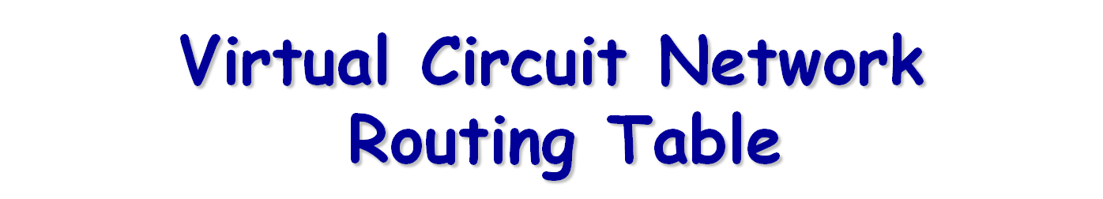
Identifier
Output
port
Next
identifier
12
13
44
Entry for packets
with identifier 15
15
15
23
27
13
16
58
7
34
Copyright ©2000 The McGraw Hill Companies
Leon-Garcia & Widjaja: Communication Networks
Figure 7.21
Computer Networks: Routing

Slide 13
Routing
Routing algorithm:: that part of the Network Layer responsible for deciding on which output line to transmit an incoming packet.
Remember: For virtual circuit subnets the routing decision is made ONLY at set up.
Algorithm properties:: correctness, simplicity, robustness, stability, fairness, optimality, and scalability.
Computer Networks: Routing

Slide 14
Routing Classification
Adaptive Routing
based on current measurements
of traffic and/or topology.
1. centralized
2. isolated
3. distributed
Non-Adaptive Routing
routing computed in advance and off-line
flooding
static routing using shortest path algorithms
Computer Networks: Routing

Slide 15
Flooding
Pure flooding :: every incoming packet to a node is sent out on every outgoing line.
  Obvious adjustment – do not send out on arriving link (assuming full-duplex links).
  The routing algorithm can use a hop counter (e.g., TTL) to dampen the flooding.
  Selective flooding :: only send on those lines going “approximately” in the right direction.
Computer Networks: Routing

Slide 16
Shortest Path Routing
Bellman-Ford Algorithm [Distance Vector]
Dijkstra’s Algorithm [Link State]
What does it mean to be the shortest (or optimal) route?
Choices:
Minimize the number of hops along the path.
Minimize mean packet delay.
Maximize the network throughput.
Computer Networks: Routing

Slide 17
Possible Metrics
Set all link costs to 1.
  Shortest hop routing.
  Disregards delay and capacity differences on links!
{Original ARPANET}
Measure the number of packets queued to be transmitted on each link.
  Did not work well.
Computer Networks: Routing

Slide 18
Metrics
{Second ARPANET}
Timestamp each arriving packet with its ArrivalTime and record DepartTime* and use link-level ACK to compute:
Delay = (DepartTime – ArrivalTime) + TransmissionTime + Latency
The weight assigned to each link was average delay over ‘recent’ packets sent.
This algorithm tended to oscillate – leading to idle periods and instability.
* Reset after retransmission
Computer Networks: Routing

Slide 19
Metrics
{Revised ARPANET}
  Compress dynamic range of the metric to account for link type
  Smooth the variation of metric with time:
    Delay transformed into link utilization
    Utilization was then averaged with last reported utilization to deal with spikes.
    Set a hard limit on how much the metric could change per measurement cycle.
Computer Networks: Routing

Slide 20
Dijkstra’s Shortest Path Algorithm
Initially mark all nodes (except source) with infinite distance.
working node = source node
Sink node = destination node
While the working node is not equal to the sink
1. Mark the working node as permanent.
2. Examine all adjacent nodes in turn
If the sum of label on working node plus distance from working node to adjacent node is less than current labeled distance on the adjacent node, this implies a shorter path. Relabel the distance on the adjacent node and label it with the node from which the probe was made.
3. Examine all tentative nodes (not just adjacent nodes) and mark the node with the smallest labeled value as permanent. This node becomes the new working node.
Reconstruct the path backwards from sink to source.
Computer Networks: Routing

Slide 21
Internetwork Routing [Halsall]
Adaptive Routing
Centralized
Distributed
Isolated
[RCC]
[IGP]
Intradomain routing
Interdomain routing
[EGP]
Interior
Gateway Protocols
[BGP,IDRP]
Exterior
Gateway Protocols
Distance Vector routing
Link State routing
[RIP]
[OSPF,IS-IS,PNNI]
Computer Networks: Routing

Slide 22
Adaptive Routing
Design Issues:
How much overhead is incurred due to gathering the routing information and sending routing packets?
What is the time frame (i.e, the frequency) for sending routing packets in support of adaptive routing?
What is the complexity of the routing strategy?
Computer Networks: Routing

Slide 23
Adaptive Routing
Basic functions:
Measurement of pertinent network data.
Forwarding of information to where the routing computation will be done.
Compute the routing tables.
Convert the routing table information into a routing decision and then dispatch the data packet.
Computer Networks: Routing

Slide 24
Centralized Routing
RCC

Slide 25
Distance Vector Routing
Historically known as the old ARPANET routing algorithm {or known as Bellman-Ford algorithm}.
Basic idea: each network node maintains a Distance Vector table containing the distance between itself and ALL possible destination nodes.
Distances are based on a chosen metric and are computed using information from the neighbors’ distance vectors.
Metric: usually hops or delay
Computer Networks: Routing

Slide 26
Distance Vector Routing
Information kept by DV router
each router has an ID
associated with each link connected to a router, there is a link cost (static or dynamic).
Distance Vector Table Initialization
Distance to itself = 0
Distance to ALL other routers = infinity number
Computer Networks: Routing

Slide 27
Distance Vector Algorithm [Perlman]
A router transmits its distance vector to each of its neighbors in a routing packet.
Each router receives and saves the most recently received distance vector from each of its neighbors.
A router recalculates its distance vector when:
  It receives a distance vector from a neighbor containing different information than before.
  It discovers that a link to a neighbor has gone down (i.e., a topology change).
The DV calculation is based on minimizing the cost to each destination.
Computer Networks: Routing

Slide 28
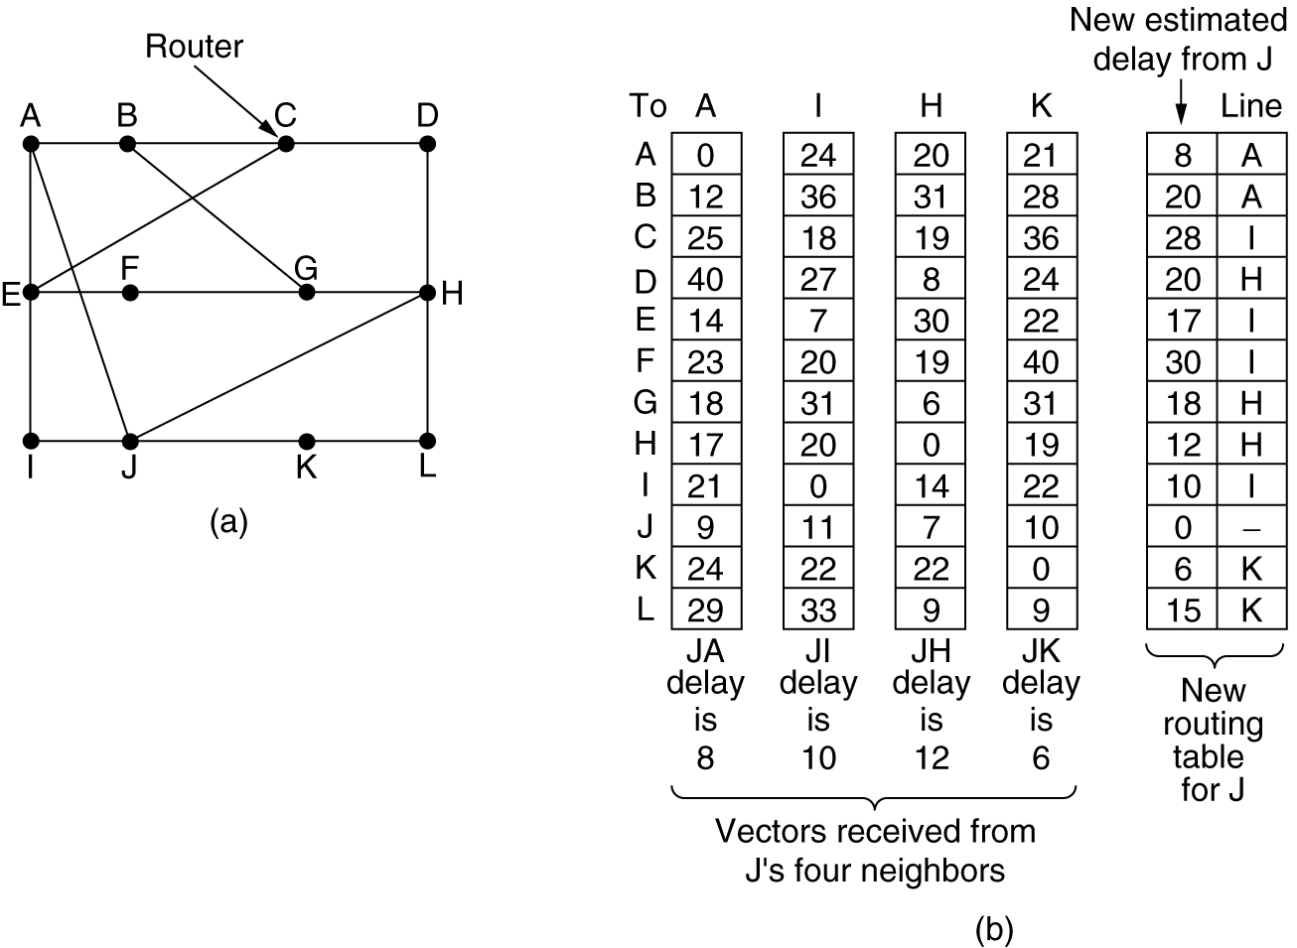
Distance Vector Routing
Figure 5-9.(a) A subnet. (b) Input from A, I, H, K, and the new routing table for J.
Computer Networks: Routing

Slide 29
Routing Information Protocol (RIP)
RIP had widespread use because it was distributed with BSD Unix in “routed”, a router management daemon.
RIP is the most used Distance Vector protocol.
RFC1058 in June 1988.
Sends packets every 30 seconds or faster.
Runs over UDP.
Metric = hop count
BIG problem is max. hop count =16
➔ RIP limited to running on small networks!!
Upgraded to RIPv2
Computer Networks: Routing

Slide 30
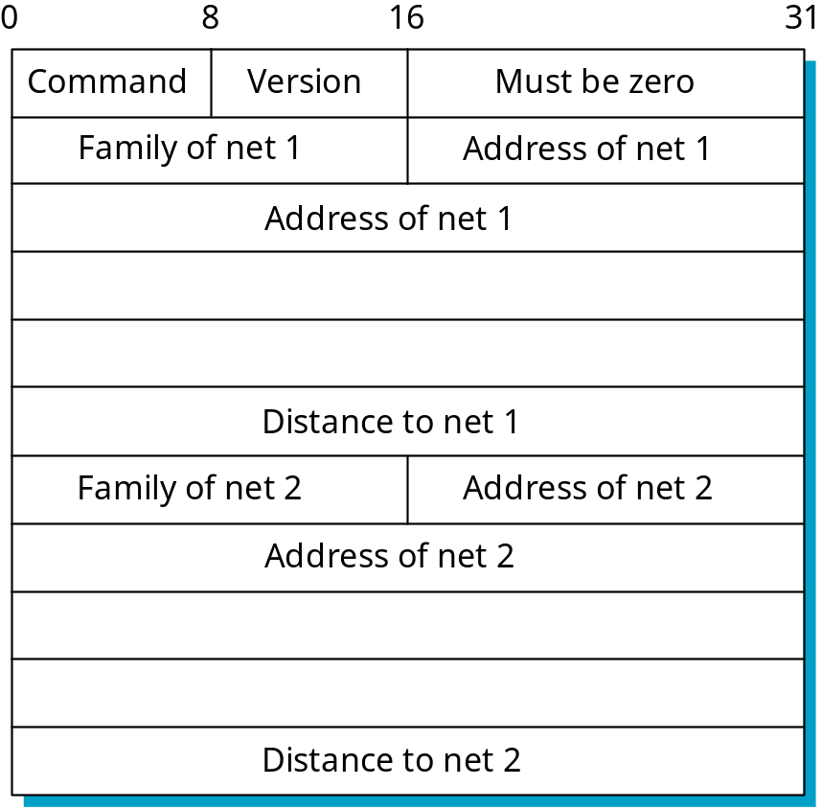
Figure 4.17 RIP Packet Format
(network_address,
distance)
pairs
P&D slide
Computer Networks: Routing

Slide 31
Link State Algorithm
Each router is responsible for meeting its neighbors and learning their names.
Each router constructs a link state packet (LSP) which consists of a list of names and cost to reach each of its neighbors.
The LSP is transmitted to ALL other routers. Each router stores the most recently generated LSP from each other router.
Each router uses complete information on the network topology to compute the shortest path route to each destination node.
Computer Networks: Routing

Slide 32
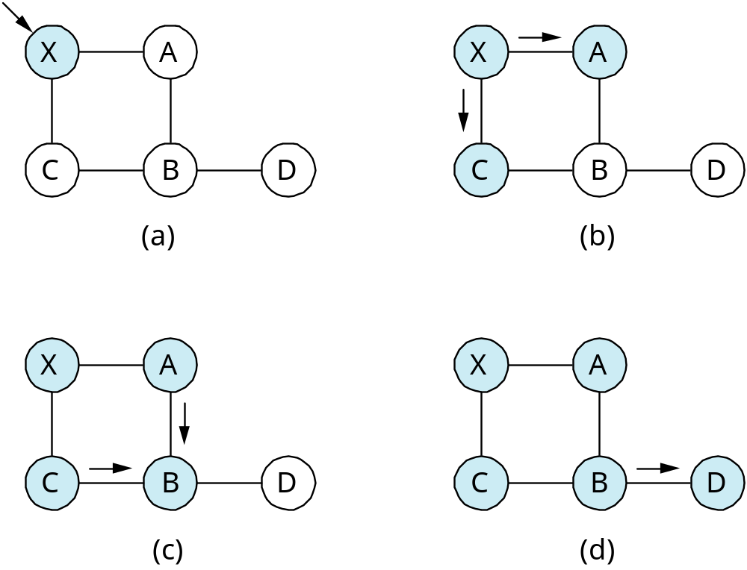
Figure 4.18 Reliable LSP Flooding
P&D slide
Computer Networks: Routing

Slide 33
Reliable Flooding
The process of making sure all the nodes participating in the routing protocol get a copy of the link-state information from all the other nodes.
LSP contains:
  Sending router’s node ID
  List of connected neighbors with the associated link cost to each neighbor
  Sequence number
  Time-to-live (TTL)
Computer Networks: Routing

Slide 34
Reliable Flooding
First two items enable route calculation
Last two items make process reliable
  ACKs and checking for duplicates is needed.
Periodic Hello packets used to determine the demise of a neighbor.
The sequence numbers are not expected to wrap around.
  ➔this field needs to be large (64 bits)
Computer Networks: Routing

Slide 35
Open Shortest Path First
(OSPF)
Provides for authentication of routing messages.
  8-byte password designed to avoid misconfiguration.
Provides additional hierarchy
  Domains are partitioned into areas.
  This reduces the amount of information transmitted in packet.
Provides load-balancing via multiple routes.
Computer Networks: Routing

Slide 36
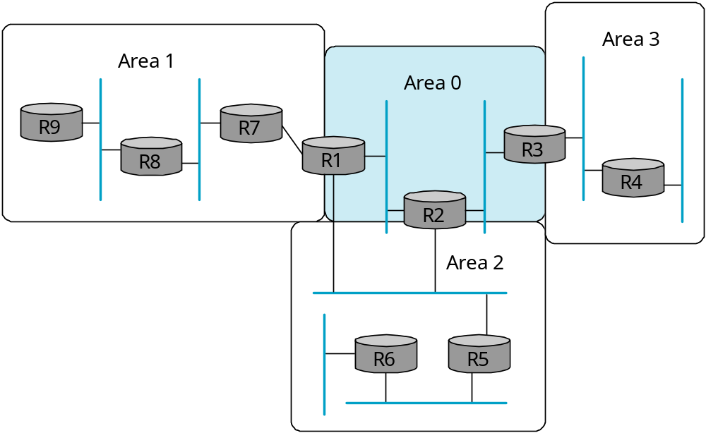
Open Shortest Path First
(OSPF)
Backbone
area
Figure 4.32 A Domain divided into Areas
P&D slide
Computer Networks: Routing

Slide 37
Open Shortest Path First
(OSPF)
OSPF runs on top of IP, i.e., an OSPF packet is transmitted with IP data packet header.
Uses Level 1 and Level 2 routers
Has: backbone routers, area border routers, and AS boundary routers
LSPs referred to as LSAs (Link State Advertisements)
Complex algorithm due to five distinct LSA types.
Computer Networks: Routing

Slide 38
OSPF Terminology
Internal router :: a level 1 router.
Backbone router :: a level 2 router.
Area border router (ABR) :: a backbone router that attaches to more than one area.
AS border router :: (an interdomain router), namely, a router that attaches to routers from other ASs across AS boundaries.
Computer Networks: Routing

Slide 39
OSPF LSA Types
Router link advertisement [Hello message]
Network link advertisement
Network summary link advertisement
AS border router’s summary link advertisement
AS external link advertisement
Computer Networks: Routing

Slide 40
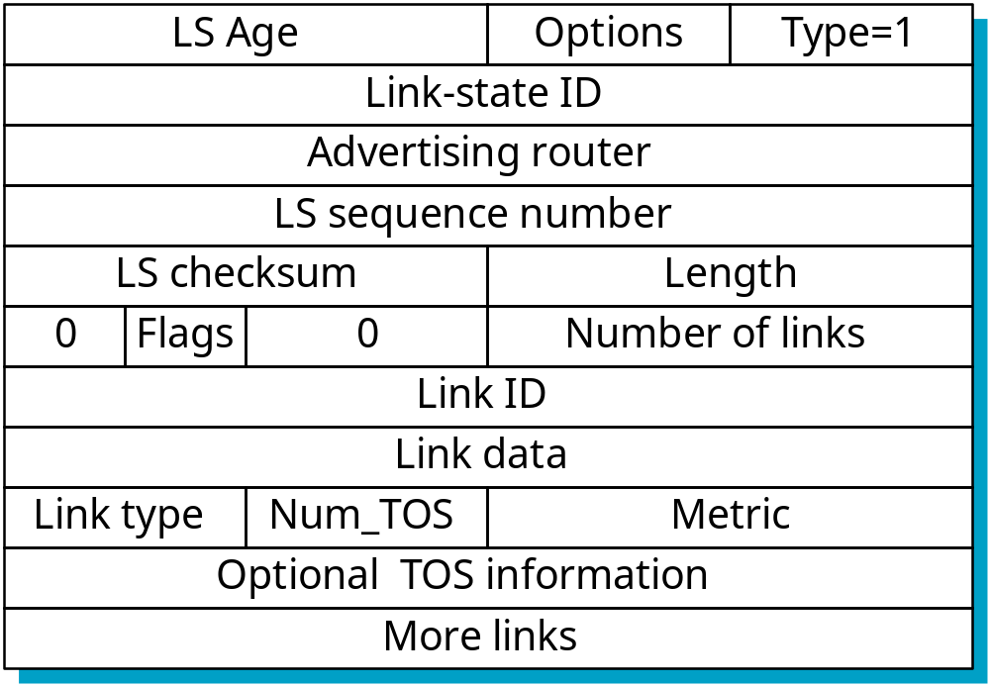
Figure 4.21 OSF Type 1 Link-State Advertisement
Indicates
LSA type
Indicates
link cost
P&D slide
Computer Networks: Routing

Slide 41
OSPF Areas
[AS Border router]
To another AS
N1
R1
N5
N2
R3
R6
N4
R7
R2
N6
R4
R5
N3
Area 0.0.0.1
Area 0.0.0.0
R8
Area 0.0.0.2
ABR
N7
R = router N = network
Area 0.0.0.3
Copyright ©2000 The McGraw Hill Companies
Leon-Garcia & Widjaja: Communication Networks
Figure 8.33
Computer Networks: Routing

Slide 42
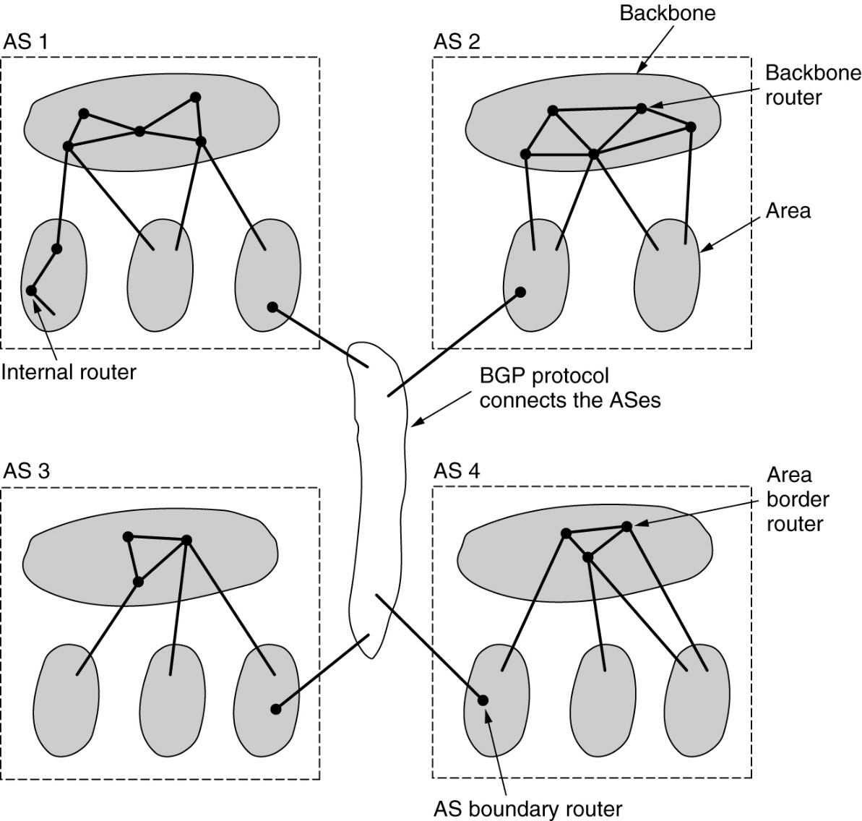
OSPF
Figure 5-65.The relation between ASes, backbones, and areas in OSPF.
Tanenbaum slide
Computer Networks: Routing

Slide 43
Border Gateway Protocol (BGP)
The replacement for EGP is BGP. Current version is BGP-4.
BGP assumes the Internet is an arbitrary interconnected set of AS’s.
In interdomain routing the goal is to find ANY path to the intended destination that is loop-free. The protocols are more concerned with reachability than optimality.
Computer Networks: Routing

